Slide 1
Bike Sewa
( B C A - 6th S E M E S T E R )
Presented by:
Ngima Sherpa (07)
Date:30th Jan 2022

Slide 2
Introduction
Web based application
The admin side and the user side are both included
User can login, booking, send request, view old servicing record, make payment and give feedback through online
Admin can manage both bike and user details and system generate different reports based on those data

Slide 3
Existing Problem
Customer can’t view old servicing details
Customer can’t book online for servicing
Customer can’t get emergency services
Customer can’t get email notification for servicing alert
Customer can’t send request for pick and drop
Not user friendly.

Slide 4
Objectives
The main objective of this project is as following.
To store repair and maintenance data of bikes
To generate weekly monthly reports

Slide 5
Scope
  It provides Customer to book for bike servicing, send request for pick and drop, view old bike servicing records, view profile, send servicing alert through online
  Service center can manage both bike and user details such as bike module, color, last servicing date, customer name, address, gender, phone, email etc.
  Service center can generate various data (total bike services, total income, total customer, upcoming servicing list, total number of booking and cancellation)

Slide 6
Limitation
It needs internet for booking
Customer have to book even without seeing actually how service center looks like
Sometime it may contain technical problems

Slide 7
Tools and Technology
Frontend tools
  HTML5
  CSS3
  JavaScript v8 8.9.255.25
Backend tools
  Java EE v8 (servlet & jsp)
  MySQL 8.0.22
Server
  Tomcat 8.5.
Others
  Eclipse 2021
  Git and GitHub
Methodology
  Waterfall model

Slide 8
Requirements
Hardware requirements(min.)
  512 MB of RAM
  Pentium 4 processor or higher
Software requirements(min.)
  Operating system : Windows XP or later
  Web browser (Chrome, Mozilla…)

Slide 9
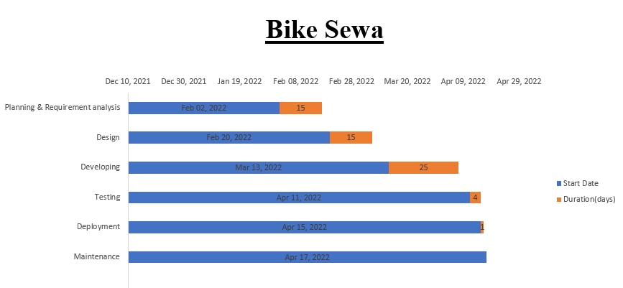
Project Timeline

Slide 10
Conclusion
Bike Sewa is an online web application that minimizes the problem of the existing system and provides an easy interface to both customers and admin. It generate weekly and monthly reports which helps to analyze business, and can increase revenue.

Slide 11
Any Questions ?

Slide 12

Thank You

